Slide 1
C# - Get Funky
Aspects of functional programming in C#

Slide 2
AGENDA
Introduction
Programming paradigms
Goals
Aspects in code
Conclusion

Slide 3
Introduction

Slide 4



whoami
{
name: “Felix Sauer”,
age: 31,
occupation: “Software-Developer”,
employer: “baramundi Software AG”,
passion: “getting funky ”
}

Slide 5










Is this for you?

Slide 6
Is this for you?
YES!

Slide 7
Programming paradigms

Slide 8


Programming paradigms
Programming paradigms are a way to classify programming languages based on their features. Languages can be classified into multiple paradigms.
- https://en.wikipedia.org/wiki/Programming_paradigm

Slide 9



Object Oriented Programming (OOP)
State combined with state-modifying functions
Encapsulation
Inheritance
Composition

Slide 10
Functional Programming
Funk
Composition of functions
Higher order functions
Determinism
Pure functions

Slide 11
Goals

Slide 12

Goals
Readability
Maintainability
Scalability

Slide 13


Aspects in Code

Slide 14

Why C#?
#
Multi-paradigm language
Wide spread
Best of two worlds
Increasing functional features

Slide 15
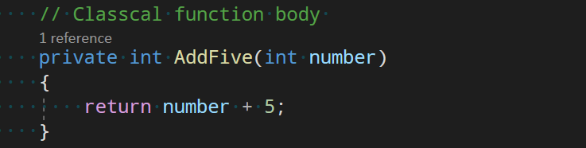

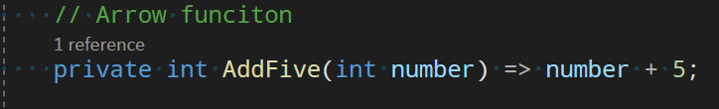
Arrow Functions

Slide 16
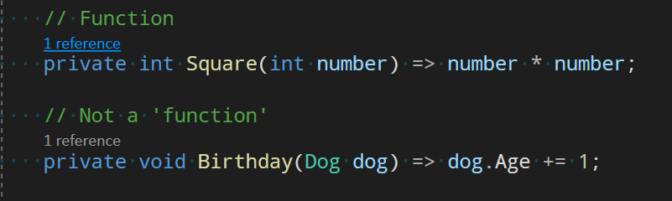
Function
f(x)=x*x

Slide 17
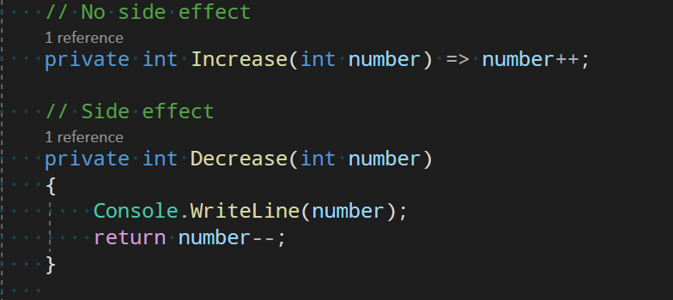

Pure Functions

Slide 18
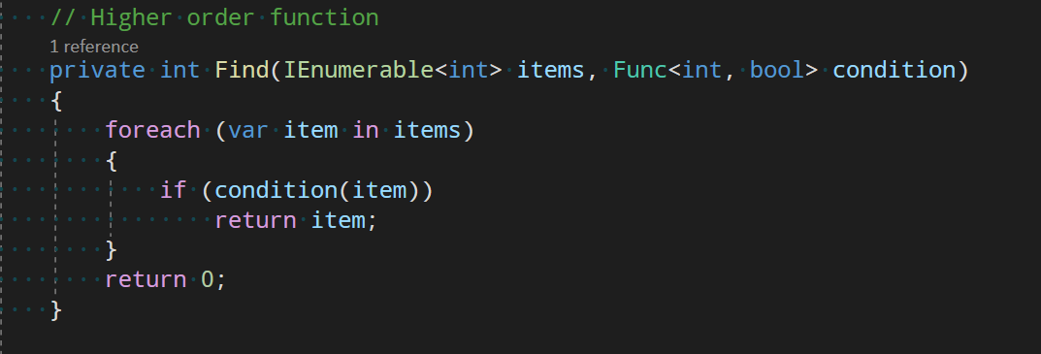

Higher Order Functions

Slide 19
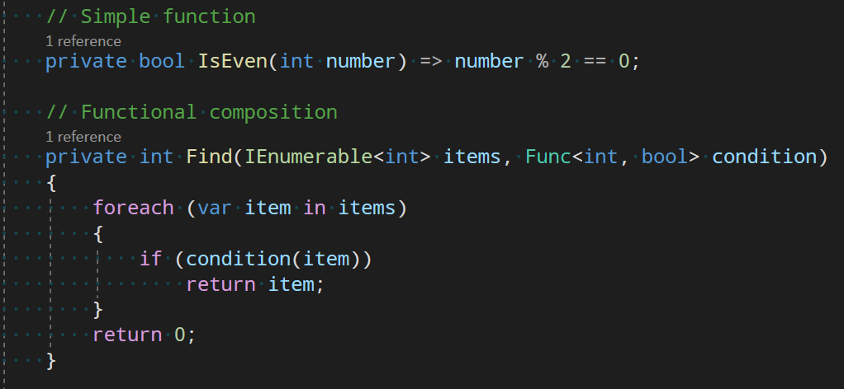


Functional Composition

Slide 20
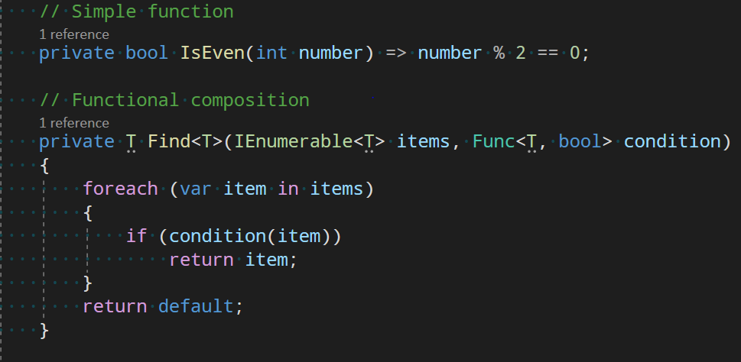
Functional Composition

Slide 21
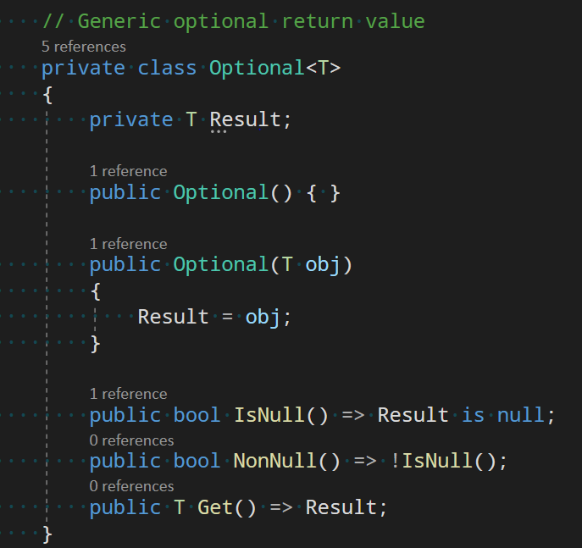

Optionals

Slide 22
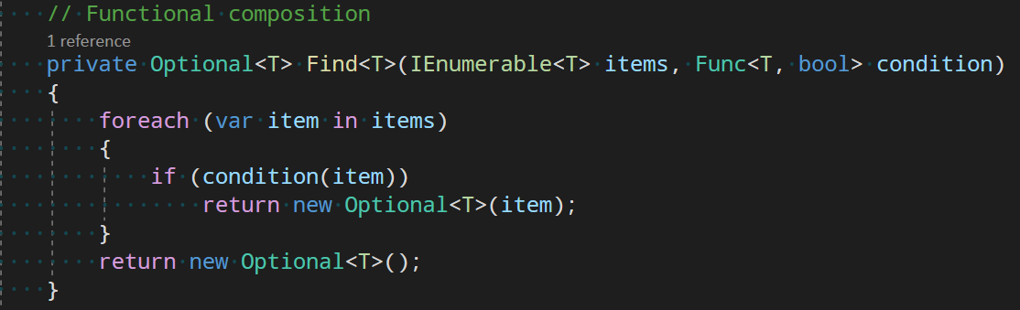
Optionals

Slide 23
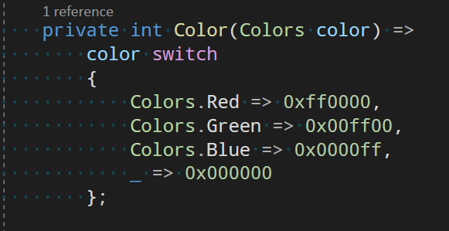

Expressiveness

Slide 24
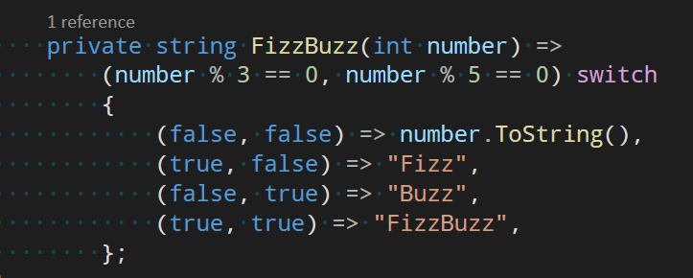
Expressiveness

Slide 25
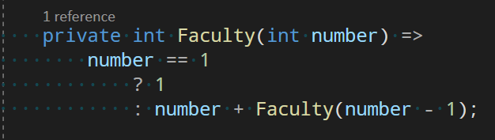
Expressiveness

Slide 26
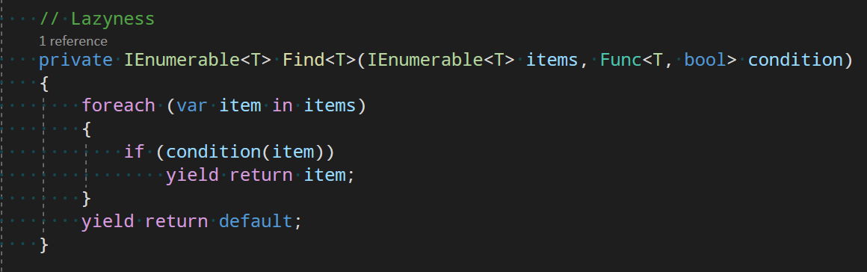

Lazyness

Slide 27
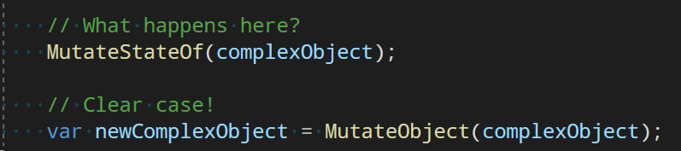

Immutability

Slide 28
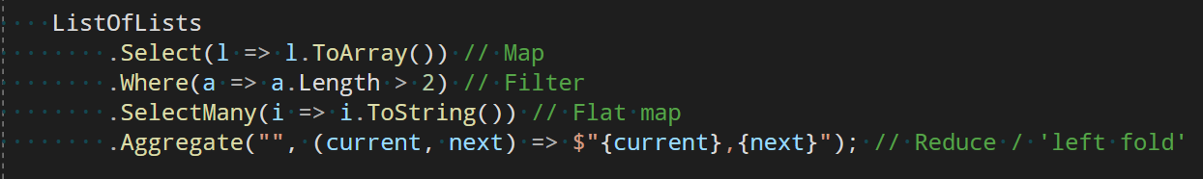






Map -> Reduce

Slide 29
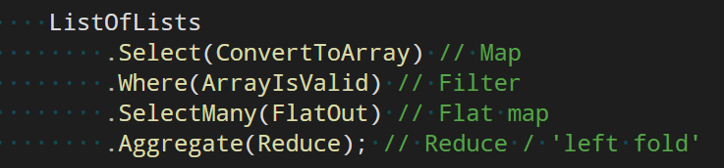
Map -> Reduce

Slide 30
Map -> Reduce

Slide 31
Conclusion
Expressions over statements
Declarative over imperative
Composition
Pure functions
Pipes
Laziness
Immutability
Small functions

Slide 32
Goals
Readability
Maintainability
Scalability

Slide 33
Stay funky
Felix Sauer
Software-Developer
717
felix.sauer@baramundi.com

